Slide 1



Class 2: Introduction to Business Intelligence
Unit I: Data Exploration and Profiling (EDA)
Sebastián Muñoz-Herrera, PhD.
Héctor Hormazábal
Notes:
Hi, Welcome everyone to Class 1 of Business Intelligence. My name is Sebastián Muñoz-Herrera, and I'll be guiding you through this course over the coming months.
Before we dive in, let me give you a quick picture of what this course is about. Business Intelligence, or BI, is one of the most in-demand skill sets in today's data-driven world. Whether you end up working in finance, logistics, healthcare, or retail, understanding how to turn raw data into decisions is a superpower.
This first class is your starting point. We'll define what BI actually means, explore why it matters, look at real-world cases here in Chile, and finish with a hands-on Python session. By the end of today, you'll have a clear mental model of what BI is — and you'll have written your first lines of data code.
But before we begin, I'd love a brief introduction from each of you. Please share your name, your areas of interest within Industrial Engineering, and something you enjoy doing in your free time.
Im Sebastián Muñoz Herrera, I am Industrial Engineer by profession, I have a Master Degree in Industrial Engineering too, and I hold a PhD in Complex Systems Engineering. My interest is in Operations Research and Machine Learning methods. I enjoy my time with my family, play soccer and write research articles.
Who wants to go first?

Slide 2
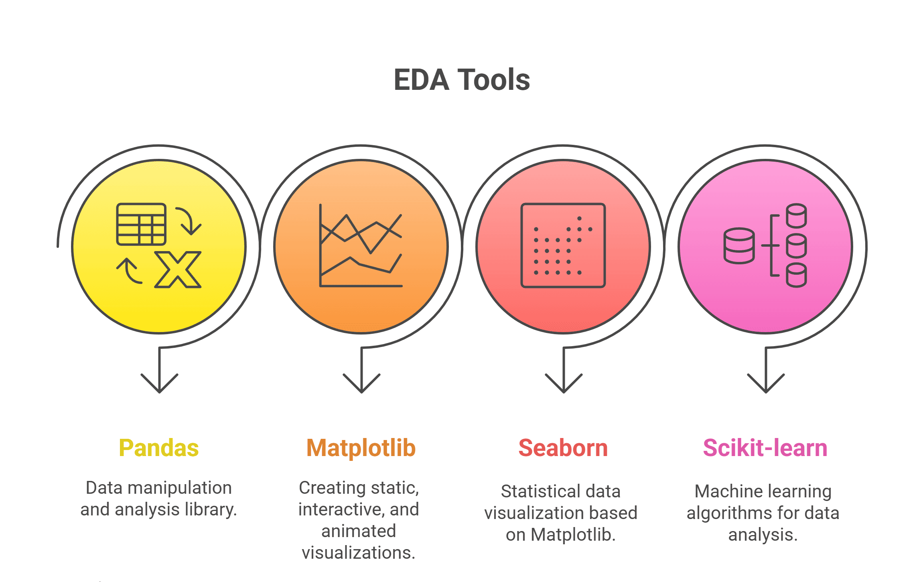
Introduction to EDA – Exploratory Data Analysis
Understanding your data before the modeling phase
The Foundation of Data Science: Conducting initial investigations to discover patterns, spot anomalies, and test hypotheses.
Why it matters: Gaining a deep understanding of the "nature" of the dataset before applying any machine learning models.
Process: A structured approach to data health, moving from basic counts to complex variable relationships.
Practical Benefit: Identifying early flaws in the data to prevent biased results or model failure later on.
Muñoz-Herrera and Hormazábal Clase 2: Data Exploration and Profiling (EDA) Unit 1: Fundamentals of Business Intelligence
Notes:
Let me walk you through the four units of the course so you know exactly where we're headed.
Unit I, which starts today, covers the Fundamentals of Business Intelligence — what it is, how it works, where data comes from.
Unit II moves into Data Preparation and Predictive Models — this is where you'll get your hands dirty cleaning and modeling data.
Unit III is the exciting one: Advanced Analytics and Machine Learning.
And Unit IV brings it all together with a focus on communicating insights ethically to support decision-making.
Notice how the course is structured like a pipeline: first you understand BI, then you prepare data, then you build models, and finally you communicate results. Each unit builds on the previous one — so keeping up with the pace really matters.
If at any point you feel lost, reach out early. We'd rather help you now than rescue you at the final exam.

Slide 3
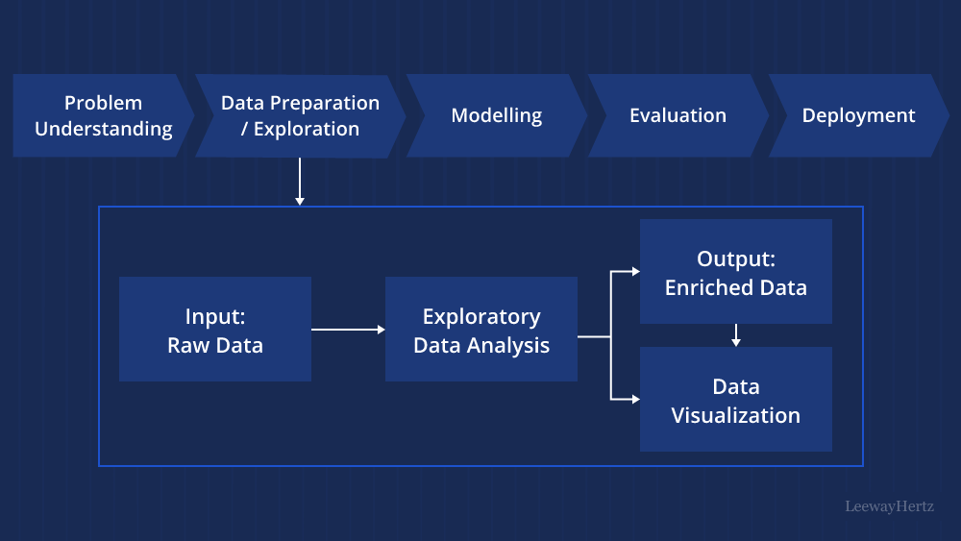
The Foundation of Data Analysis
Core Purpose and Analytical Structure
Main Objective: To maximize insight into the dataset and uncover underlying patterns or trends.
Data Sanitization: Early detection and handling of outliers, missing values, and anomalies.
Feature Importance: Identifying which variables are the most influential for future modeling.
Analysis Flow: Moving from Univariate (single variable) to Bivariate and Multivariate investigations.
Muñoz-Herrera and Hormazábal Clase 2: Data Exploration and Profiling (EDA) Unit 1: Fundamentals of Business Intelligence
Notes:
Let me walk you through the four units of the course so you know exactly where we're headed.
Unit I, which starts today, covers the Fundamentals of Business Intelligence — what it is, how it works, where data comes from.
Unit II moves into Data Preparation and Predictive Models — this is where you'll get your hands dirty cleaning and modeling data.
Unit III is the exciting one: Advanced Analytics and Machine Learning.
And Unit IV brings it all together with a focus on communicating insights ethically to support decision-making.
Notice how the course is structured like a pipeline: first you understand BI, then you prepare data, then you build models, and finally you communicate results. Each unit builds on the previous one — so keeping up with the pace really matters.
If at any point you feel lost, reach out early. We'd rather help you now than rescue you at the final exam.

Slide 4
Data Taxonomy: Numerical vs. Categorical
Classifying Variables for appropriate statistical analysis
Type | Sub-type | Description | Example
Numerical | Continuous | Infinite values within a specific range. | Price, Weight, Time
Numerical | Discrete | Countable, distinct whole numbers. | No. of children, Cars
Categorical | Ordinal | Clear, logical sequence or rank. | Education, Ratings
Categorical | Nominal | No inherent order or hierarchy. | Country, Gender, ID
Muñoz-Herrera and Hormazábal Clase 2: Data Exploration and Profiling (EDA) Unit 1: Fundamentals of Business Intelligence
Notes:
Let me walk you through the four units of the course so you know exactly where we're headed.
Unit I, which starts today, covers the Fundamentals of Business Intelligence — what it is, how it works, where data comes from.
Unit II moves into Data Preparation and Predictive Models — this is where you'll get your hands dirty cleaning and modeling data.
Unit III is the exciting one: Advanced Analytics and Machine Learning.
And Unit IV brings it all together with a focus on communicating insights ethically to support decision-making.
Notice how the course is structured like a pipeline: first you understand BI, then you prepare data, then you build models, and finally you communicate results. Each unit builds on the previous one — so keeping up with the pace really matters.
If at any point you feel lost, reach out early. We'd rather help you now than rescue you at the final exam.

Slide 5
Data Profiling - Health Check
Data Profiling: Assessing Dataset Health
Metric | Focus | Description | Example Issue | Impact
Completeness | Missing Data | Presence of null or NaN values. | 30% of "Age" is missing. | Biased or skewed results.
Uniqueness | Duplicates | Identification of redundant records. | Same transaction id twice. | Overestimated metrics.
Consistency | Standards | Uniformity of formats/labels. | "USA" vs. "U.S.A." | Fragmented categories.
Validity | Constraints | Adherence to logical ranges. | Age = -5 or Salary = "N/A". | Computational errors.
Accuracy | Correctness | Degree of truth in the data. | A sensor reporting 500°C. | Unreliable model logic.
Muñoz-Herrera and Hormazábal Clase 2: Data Exploration and Profiling (EDA) Unit 1: Fundamentals of Business Intelligence
Notes:
Let me walk you through the four units of the course so you know exactly where we're headed.
Unit I, which starts today, covers the Fundamentals of Business Intelligence — what it is, how it works, where data comes from.
Unit II moves into Data Preparation and Predictive Models — this is where you'll get your hands dirty cleaning and modeling data.
Unit III is the exciting one: Advanced Analytics and Machine Learning.
And Unit IV brings it all together with a focus on communicating insights ethically to support decision-making.
Notice how the course is structured like a pipeline: first you understand BI, then you prepare data, then you build models, and finally you communicate results. Each unit builds on the previous one — so keeping up with the pace really matters.
If at any point you feel lost, reach out early. We'd rather help you now than rescue you at the final exam.

Slide 6
Spotting Anomalies in Your Data
Identifying extreme observations and their Impact
Defining the Outlier: Think of these as data points that simply don't "fit in" with the rest of your observations.
The Root Cause: Most outliers come from manual entry errors, equipment glitches, or genuine but rare events that break the norm.
Why we worry: A single extreme value can easily distort your average, making your entire analysis look skewed or dishonest.
The Box Plot Advantage: It’s the fastest way to visualize your distribution and see which points are sitting outside the "safety zone."
Muñoz-Herrera and Hormazábal Clase 2: Data Exploration and Profiling (EDA) Unit 1: Fundamentals of Business Intelligence
Notes:
Let me walk you through the four units of the course so you know exactly where we're headed.
Unit I, which starts today, covers the Fundamentals of Business Intelligence — what it is, how it works, where data comes from.
Unit II moves into Data Preparation and Predictive Models — this is where you'll get your hands dirty cleaning and modeling data.
Unit III is the exciting one: Advanced Analytics and Machine Learning.
And Unit IV brings it all together with a focus on communicating insights ethically to support decision-making.
Notice how the course is structured like a pipeline: first you understand BI, then you prepare data, then you build models, and finally you communicate results. Each unit builds on the previous one — so keeping up with the pace really matters.
If at any point you feel lost, reach out early. We'd rather help you now than rescue you at the final exam.

Slide 7
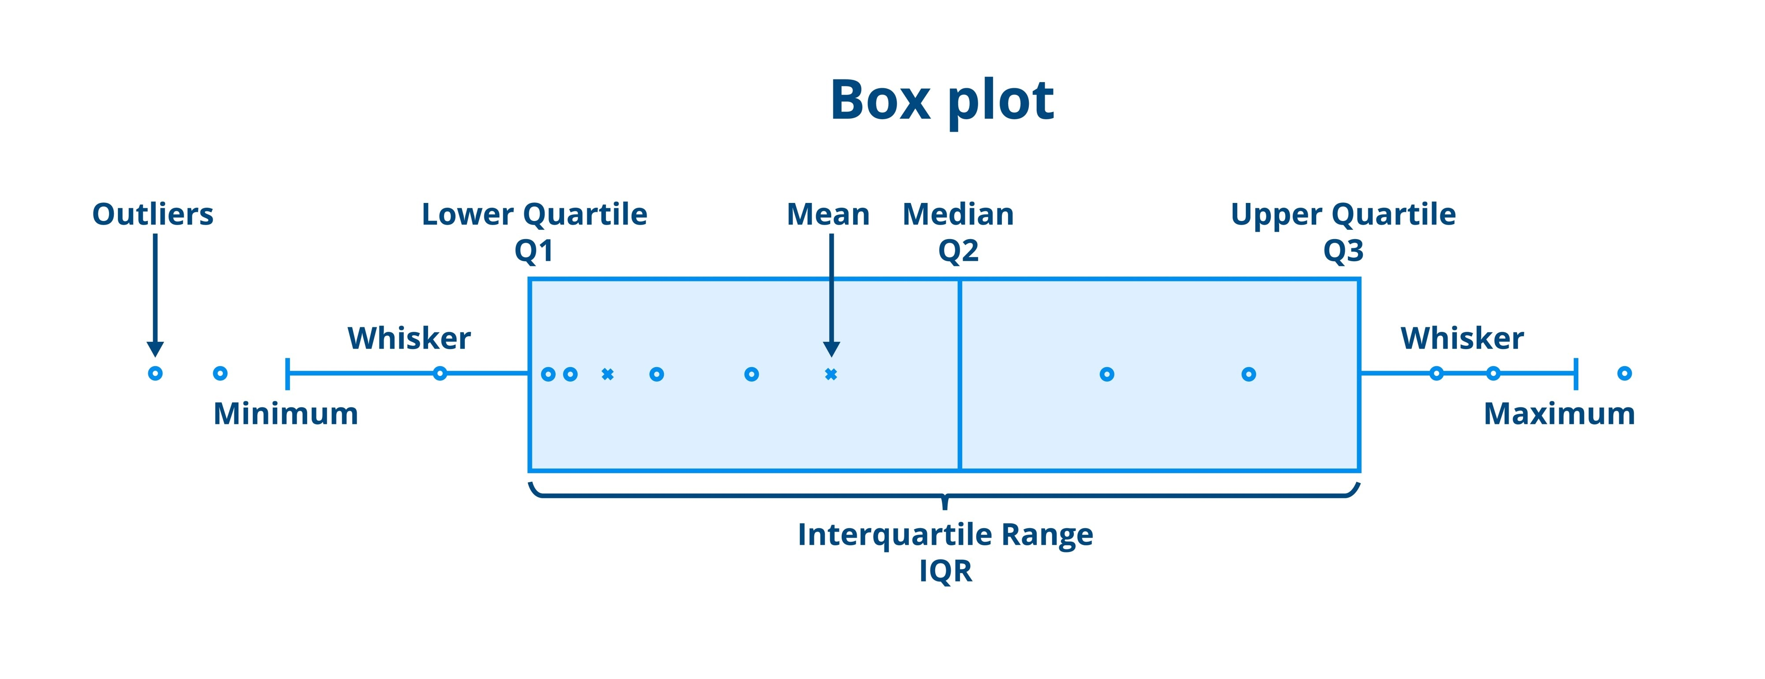
Spotting Anomalies in Your Data
Identifying extreme observations and their Impact
Muñoz-Herrera and Hormazábal Clase 2: Data Exploration and Profiling (EDA) Unit 1: Fundamentals of Business Intelligence
Notes:
Let me walk you through the four units of the course so you know exactly where we're headed.
Unit I, which starts today, covers the Fundamentals of Business Intelligence — what it is, how it works, where data comes from.
Unit II moves into Data Preparation and Predictive Models — this is where you'll get your hands dirty cleaning and modeling data.
Unit III is the exciting one: Advanced Analytics and Machine Learning.
And Unit IV brings it all together with a focus on communicating insights ethically to support decision-making.
Notice how the course is structured like a pipeline: first you understand BI, then you prepare data, then you build models, and finally you communicate results. Each unit builds on the previous one — so keeping up with the pace really matters.
If at any point you feel lost, reach out early. We'd rather help you now than rescue you at the final exam.

Slide 8
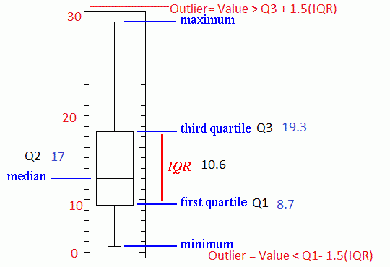
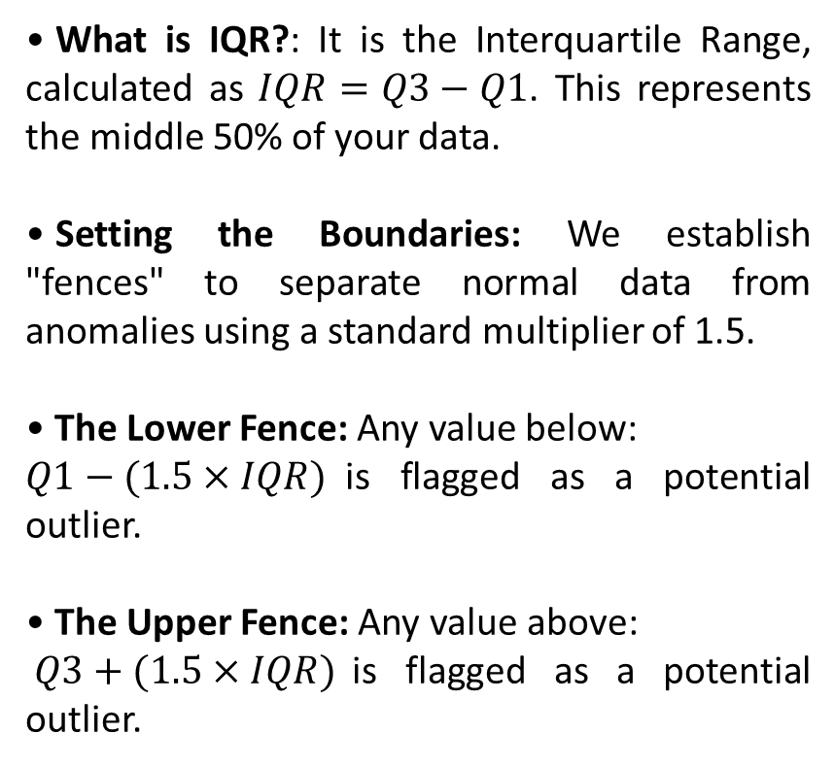
Calculating the "Safety Zone"
The Mathematical Standard for Outlier Detection
What is IQR?: It is the Interquartile Range, calculated as $IQR=Q3−Q1$. This represents the middle 50% of your data.
Setting the Boundaries: We establish "fences" to separate normal data from anomalies using a standard multiplier of 1.5.
The Lower Fence: Any value below:
$Q1−(1.5×IQR)$is flagged as a potential outlier.
The Upper Fence: Any value above:
$Q3+(1.5×IQR)$is flagged as a potential outlier.
Muñoz-Herrera and Hormazábal Clase 2: Data Exploration and Profiling (EDA) Unit 1: Fundamentals of Business Intelligence
Notes:
Let me walk you through the four units of the course so you know exactly where we're headed.
Unit I, which starts today, covers the Fundamentals of Business Intelligence — what it is, how it works, where data comes from.
Unit II moves into Data Preparation and Predictive Models — this is where you'll get your hands dirty cleaning and modeling data.
Unit III is the exciting one: Advanced Analytics and Machine Learning.
And Unit IV brings it all together with a focus on communicating insights ethically to support decision-making.
Notice how the course is structured like a pipeline: first you understand BI, then you prepare data, then you build models, and finally you communicate results. Each unit builds on the previous one — so keeping up with the pace really matters.
If at any point you feel lost, reach out early. We'd rather help you now than rescue you at the final exam.

Slide 9
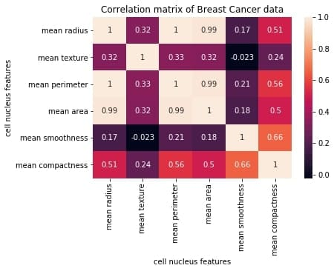
Pearson Correlation Matrix ($r$)
Measuring the strength of linear relationships
Definition: It is a statistical measure that quantifies how much two variables change together. It specifically looks for linear patterns.
The Scale: The value of r always ranges from -1 to +1, where the sign indicates the direction and the number indicates the strength.
Positive vs. Negative:
+1.0: As one variable increases, the other increases in a perfect straight line.
-1.0: As one variable increases, the other decreases consistently.
The Null Point (0): A correlation of 0 means there is no linear relationship; the variables are independent of each other in a linear sense.
Muñoz-Herrera and Hormazábal Clase 2: Data Exploration and Profiling (EDA) Unit 1: Fundamentals of Business Intelligence
Notes:
Let me walk you through the four units of the course so you know exactly where we're headed.
Unit I, which starts today, covers the Fundamentals of Business Intelligence — what it is, how it works, where data comes from.
Unit II moves into Data Preparation and Predictive Models — this is where you'll get your hands dirty cleaning and modeling data.
Unit III is the exciting one: Advanced Analytics and Machine Learning.
And Unit IV brings it all together with a focus on communicating insights ethically to support decision-making.
Notice how the course is structured like a pipeline: first you understand BI, then you prepare data, then you build models, and finally you communicate results. Each unit builds on the previous one — so keeping up with the pace really matters.
If at any point you feel lost, reach out early. We'd rather help you now than rescue you at the final exam.

Slide 10
Sumary
The iterative nature of data preprocessing
Iterative Process: Preprocessing isn't a straight line. Discovering new patterns often requires circling back to cleaning and re-evaluating features.
Granular Cleaning: Handling missing values through strategic imputation and removing duplicate records to prevent bias in the final metrics.
Label Consistency: Standardizing categories and fixing naming inconsistencies to ensure the model doesn't treat identical labels as different features.
Outlier Management: Using the IQR Method to decide if extreme values are data entry errors to be removed or critical business signals to be kept.
Dimensionality & Encoding: Filtering redundant features using the Pearson Matrix and transforming text into binary indicators for machine readability.
Muñoz-Herrera and Hormazábal Clase 2: Data Exploration and Profiling (EDA) Unit 1: Fundamentals of Business Intelligence
Notes:
Let me walk you through the four units of the course so you know exactly where we're headed.
Unit I, which starts today, covers the Fundamentals of Business Intelligence — what it is, how it works, where data comes from.
Unit II moves into Data Preparation and Predictive Models — this is where you'll get your hands dirty cleaning and modeling data.
Unit III is the exciting one: Advanced Analytics and Machine Learning.
And Unit IV brings it all together with a focus on communicating insights ethically to support decision-making.
Notice how the course is structured like a pipeline: first you understand BI, then you prepare data, then you build models, and finally you communicate results. Each unit builds on the previous one — so keeping up with the pace really matters.
If at any point you feel lost, reach out early. We'd rather help you now than rescue you at the final exam.

Slide 11

Practical Section
Data Profiling | Exploration with .info(), .describe() and .isna() to assess integrity.
Data Cleaning | Standardization of categories using .str methods and duplicate removal.
Outlier Detection | Practical application of the IQR Method to identify extreme values.
Statistical Analysis | Understanding Skewness by comparing Mean vs. Median in histograms.
Correlation Study | Visualizing relationships with Pearson Matrices and Scatter Plots.
Muñoz-Herrera and Hormazábal Clase 2: Data Exploration and Profiling (EDA) Unit 1: Fundamentals of Business Intelligence

Slide 12
Class 2: Introduction to Business Intelligence
Unit I: Data Exploration and Profiling (EDA)
Sebastián Muñoz-Herrera, PhD.
Héctor Hormazábal

